Slide 1
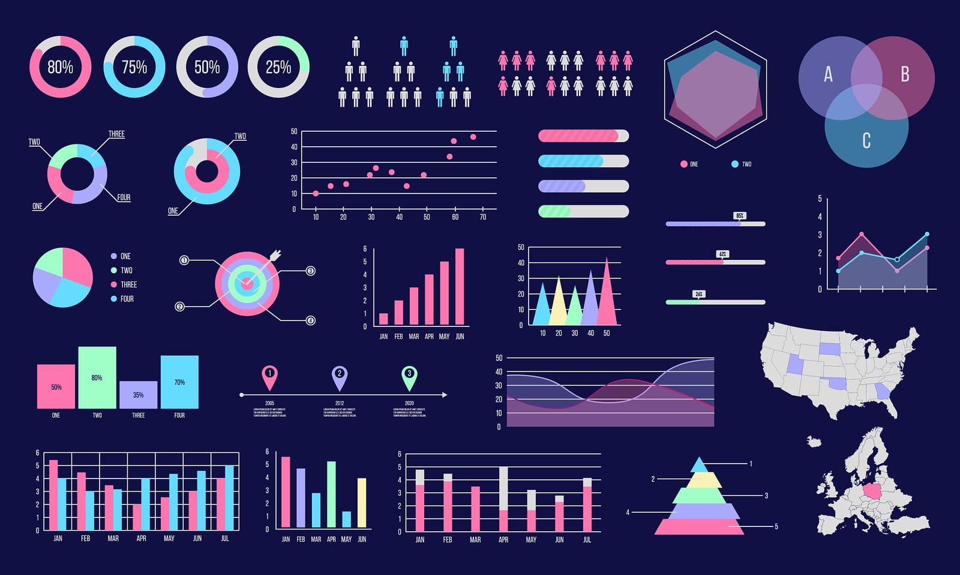
E-commerce Funnel Visualization: Insights from User Behavior
Anuj Patel
Masters in Robotics
Jaimin Sorathiya
Masters in Electrical and Computer Eng.

Slide 2

Problem Statement
Problem Statement:
E-commerce platforms face significant challenges in understanding and improving their customer journey. Common issues include:
1) High Cart Abandonment: Approximately 70% of online shopping carts globally are abandoned before purchase.
2) Funnel Drop-offs: Identifying exactly where and why users lose interest remains difficult, causing revenue losses.
3) Timing Optimization: Businesses often lack insights into when users are most engaged and likely to purchase.

Slide 3

Motivation & Objectives:
Motivation & Objectives
Given these challenges, this project aims to create an interactive visualization tool using real user behavior data from Taobao, leading e-commerce platform.
Our goal is to help businesses:
Clearly visualize user journeys and identify funnel bottlenecks.
Gain actionable insights into customer behavior patterns.
Make data-driven decisions to boost conversions, optimize marketing, and improve user experience.
Identifies peak engagement times to optimize ad campaigns and promotions.
Empowers businesses to reduce abandonment rates and increase ROI.
Notes:
🔍 Why This Matters
For every 1% improvement in conversion rates:
Businesses could save millions in marketing costs.
Users experience smoother journeys, fostering brand loyalty.

Slide 4

Real-world Impact & Applications
This project addresses critical needs in the e-commerce industry by providing actionable insights and visual analytics that can transform how businesses engage with their customers.
Key Applications:
📈 Conversion Optimization Clearly identify where customers drop off, enabling targeted improvements to increase sales.
🎯 Personalized Marketing Campaigns Understand customer behavior patterns to create highly targeted and effective marketing strategies.
🖥️ Enhanced User Experience (UX) Discover pain points and friction areas within the user journey, improving customer satisfaction and retention.
💡 Data-driven Decision-making Equip businesses with clear, visual insights to confidently make informed marketing, operational, and strategic decisions.
🎯 Beneficiaries
Online retail businesses (e.g., Amazon, Walmart)
Marketing & sales analysts
UX/UI designers and product teams Decision-makers seeking clear insights from large-scale user data

Slide 5
Data Overview
We will leverage a large-scale, real-world dataset that captures genuine user interactions from Taobao, one of largest e-commerce platforms.
📂 Data Source & Timeframe:
Source: Taobao via StarRocks Forum Collection Period: November 25 – December 2, 2017 (8 days)
🔢 Dataset Size & Scale: Total Records: 86,953,525 (~87 million interactions)
📌 Key Features Included:
Users: 987,982 unique users (~1 million )
Products: 3,962,559 (~4 million )
unique items Product Categories: 9,377
Behavior Types Captured:
Behavior Type | Meaning
pv | Page View
cart | Add product to cart
fav | Mark product as favorite
buy | Complete purchase transaction

Slide 6
Visualization Techniques (Planned)
Planned Visualization Techniques
Our project will implement advanced visualization methods to clearly illustrate user behaviors, funnel drop-offs, and key patterns within the dataset.
1. 📊 Interactive Funnel Charts
Clearly visualize and quantify user progression:
Page View → Add to Cart → Favorite → Purchase
Highlight critical points where users typically drop off.
2. 🕒 Temporal Heatmaps
Visualize user interactions by hour of day and day of the week.
Quickly identify peak activity periods:
Optimal marketing times
High-conversion windows
3. 🛤️ User Journey Timelines
Illustrate typical sequences of user interactions.
Identify common paths leading to final purchase or cart abandonment.

Slide 7
Technical Tools
We will use a robust, modern, and user-friendly technology stack to build our interactive visualization and analysis tool.
⚙️ Core Framework
Streamlit
Interactive, user-friendly web applications for rapid development using Python for interactive visualizations
🐍 Programming Languages & Libraries
Python
pandas (data manipulation & cleaning)
Dask (handling large datasets efficiently)
PyArrow (reading & processing Parquet data)
DuckDB (fast, efficient data queries)
📈 Visualization Libraries
Plotly
Interactive and dynamic charts
Matplotlib & Seaborn
Exploratory data analysis and static visualizations
🚀Deployment & Hosting
Streamlit Cloud
Easy hosting, sharing, and public accessibility of the final tool

Slide 8
Contributions & Novelty (Proposed)
Our Planned Contributions:
Interactive, user-friendly funnel visualization tool
Practical insights for optimizing e-commerce funnels
Novelty & Originality:
Integration of large-scale funnel analytics in a single interactive tool
Unique visualization approach for clearly showing funnel drop-offs and behavior patterns
Notes:
2

Slide 9
Anticipated Challenges & Solutions
🚧 Challenges | 💡 Proposed Solutions
Large Dataset Handling (~87 million interactions) | Data Aggregation: Using Dask and DuckDB for efficient processing and analysis.
Complex Visualization Design | Simplified Visual Design: Clear, intuitive funnel visualizations and interactive heatmaps.
Notes:
1

Slide 10
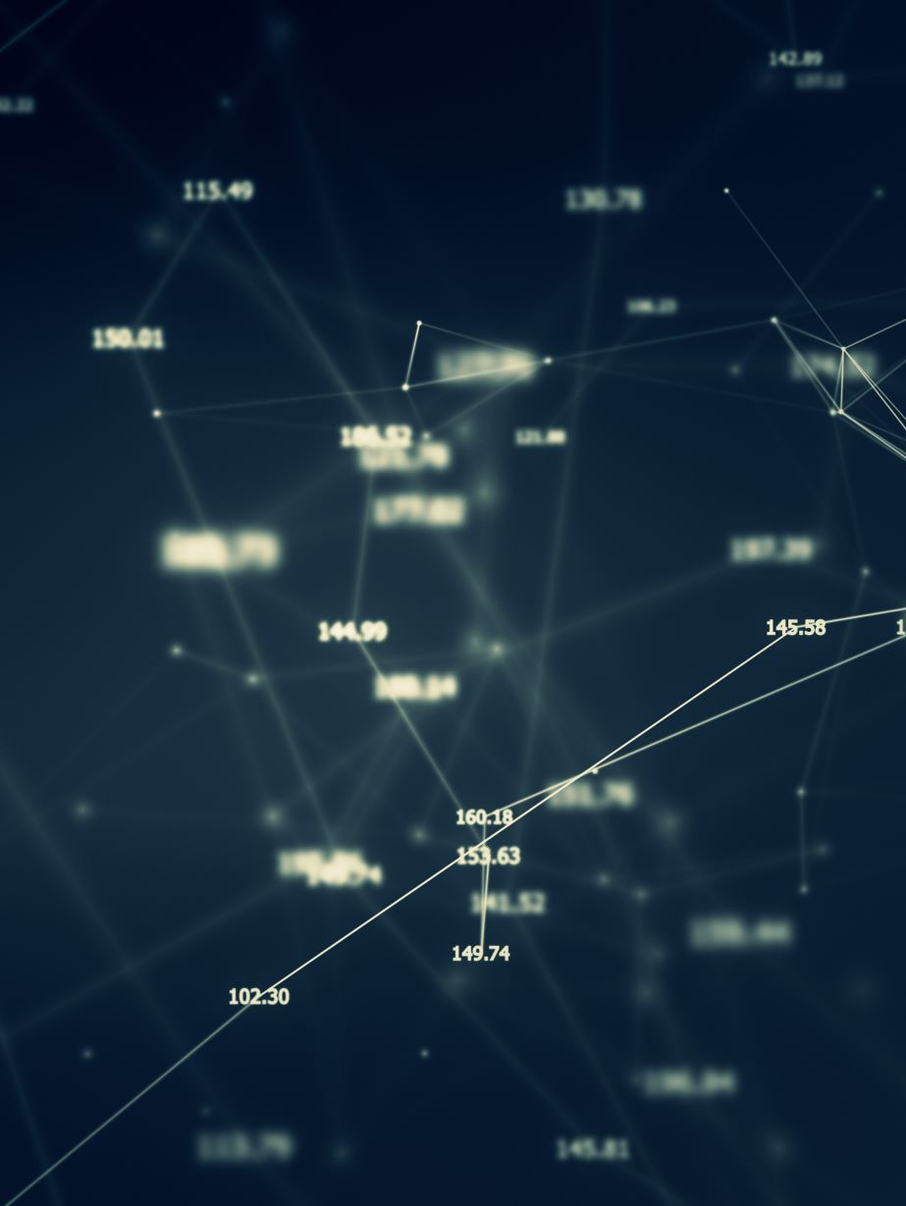
References
Dataset: StarRocks Taobao Dataset
Visualization Framework: Streamlit
Data Analysis Libraries:
pandas
Dask
Plotly
Database Performance: DuckDB

Slide 11

Thank You
Any Question

